Slide 1

Microsoft Azure Data Masterclass
Bianca Furtuna bifurt@microsoft.com
David Gristwood davidgri@Microsoft.com

Slide 2
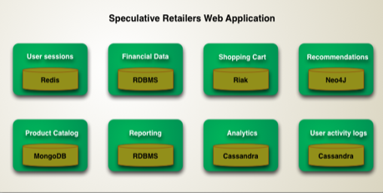
Polyglot Persistence
Different databases are designed to solve different problems. Using a single database engine for all of the requirements usually leads to non-optimal solutions
“Increasingly we see applications manage their own data using different technologies depending on how the data is used…. this will come at a cost in complexity. Each data storage mechanism introduces a new interface to be learned…”
* Don't take the example in the diagram too seriously. I'm not making any recommendations about which database technology to use for what kind of service. But I do think that people should consider these kinds of technologies as part of application architecture.
Martin Fowler*

Slide 3
Data on the cloud – high level trend
Line of Business
Documents
Transactional integrity, operational information, etc.
Independent, telemetry, insights, etc.

Slide 4
Data on Azure
services
VMs
Azure
storage
Relational
NoSQL
Big Data
Cache
Search

Slide 5
Use an appropriate type of Store
Storage Mechanism | Interaction | Starts at* | Min GB | Max TB | Use Case
‘Cool’ Block Blob storage | REST (Blob), SDKs | £0.01/GB | 0 | 500 | Archive, nearline unstructured https storage
‘Hot’ Block Blob storage | REST (Blob), SDKs | £0.02/GB | 0 | 500 | Online unstructured https storage
Virtual Machine Disk / Page Blob Storage | VM Only | £0.05/GB | 0 | 500 (Not per VM) | High Performance storage, up to 500 IOPS per disk volume (up to max volumes per VM type).
Table Storage | REST (Blob), SDKs | £0.07/GB | 0 | 500 | Tabular, non-relational (NoSQL) Mass-scale dictionary https lookup service, partitioned by default, no secondary indexes allowed.
Premium Virtual Machine Disk/ Page Blob Storage | VM Only | £0.13/GB | 128 | 35 | GUARANTEED High Performance storage, up to 5000 IOPS per disk volume (up to max volumes per VM type > 80,000 IOPS & 2TB / Second).
SQL Database Basic | T-SQL (TDS) | £2.33/GB * | 2 | 1 | Tabular, Scalable, Classic Relational DBMS, Always On
SQL Data Warehouse | T-SQL (TDS) | £1.03/GB * | 1024 | ~250 Compressed (~1PB) | Scalable, Tabular, Parallelized, Relational DBMS, can be paused.
DocumentDB | REST (Blob), SDKs | £4.62/GB * | 1 | 0.01 (10GB) | JSON Indexed document storage, can be partitioned.
Data Lake Store | WebHDFS | £0.06/GB * | 1024 | 1PB per file (!) | Hadoop based unstructured data storage layer. – Preview price includes 50% discount off US pricing, not available in Europe yet.
* These are indicative numbers, these numbers are variable on a number of factors. For example SQL DW starts billing at 1TB of capacity, storage has an access charge per million transactions.

Slide 6
Azure Storage

Slide 7
Azure Storage
Azure Storage is the cloud storage solution for modern applications that rely on durability, high availability, and scalability. It is highly scalable, elastic, globally accessible, and automatically load-balances your data
Massively scalable, highly available data store for hundreds of terabytes of data
Used by Skype, Office 365, XBox, OneDrive
Stores more than 120 Trillion objects
Multiple redundancy options to never loose data
Encryption at rest, Key Vault integration
Notes:
https://docs.microsoft.com/en-gb/azure/storage/storage-table-design-guide

Slide 8
Azure Storage Services
IaaS
PaaS
Virtual machines
Existing frameworks
Web and mobile
Microservices
Serverless Compute
Storage
Networking
Disks
Persistent disks for Azure IaaS VMs
Premium Storage Disks option: SSD based, high IOPS, low latency
Files
Fully Managed File Shares in the Cloud
SMB and REST access
“Lift and shift” legacy apps
Blobs
Highly scalable, REST based cloud object store
Block Blobs: Sequential file I/O
Cool Tier Available
Page Blobs: Random-write pattern data
Append Blobs
Tables
Massive auto-scaling NoSQL store
Dynamic scaling based on load
Scale to PBs of table data
Fast key/value lookups
Queues
Reliable queues at scale for cloud services
Decouple and scale components
Message visibility timeout and update message to protect against unreliable dequeuers
Built on a unified Distributed Storage System
Durability, Encryption at Rest, Strongly Consistent Replication, Fault Tolerance, Auto Load-Balancing

Slide 9
Azure Storage
Blob Storage stores unstructured object data and can be any type of text or binary data, such as a document, media file, etc.
60 MB/sec or 500 requests/sec target throughput
Hot storage tier optimized for accessed frequently, cool storage infrequently accessed and long-lived
Table Storage stores structured datasets. Table storage is a NoSQL key-attribute data store, which allows for rapid development and fast access to large quantities of data
1 MB max size of entity with a max 255 properties
Single RowKey with additional ParitionKey, 1 KB max size
Queue Storage provides reliable messaging for workflow processing and for communication between components of cloud services
2000 messages/sec target throughput
File Storage offers shared storage for traditional applications using SMB protocol. Azure virtual machines can share file data via mounted shares
5 TB max size of file share, 1 TB max size of a file in a share
60 MB/sec target throughput
Notes:
https://docs.microsoft.com/en-gb/azure/storage/storage-table-design-guide
https://docs.microsoft.com/en-gb/azure/storage/storage-scalability-targets

Slide 10
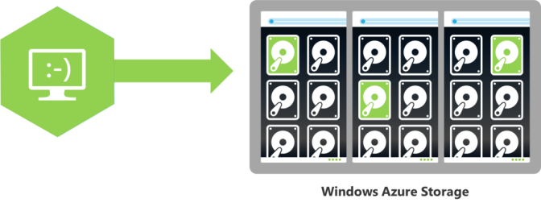
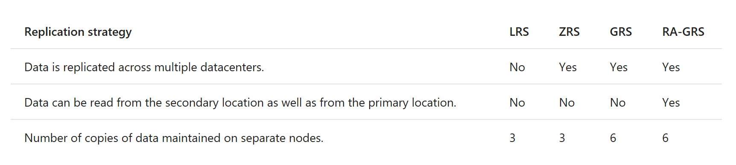
Azure Storage - Replication
Multiple copies of data always stored
Replication options:
Locally redundant storage
Zone-redundant storage
Geo-redundant storage
Read-access geo-redundant storage
Notes:
https://docs.microsoft.com/en-gb/azure/storage/storage-table-design-guide
https://docs.microsoft.com/en-gb/azure/storage/storage-scalability-targets

Slide 11
Azure Storage - Replication
Replication strategy | LRS | ZRS | GRS | RA-GRS | Premium-LRS
Data is written synchronously to multiple nodes. | Yes | Yes | Yes | Yes | Yes
Data is replicated async across multiple facilities. | No | Yes | Yes | Yes | No
Data can be read from the secondary location as well as from the primary location. | No | No | No | Yes | No
Number of copies of data maintained on separate nodes. | 3 | 3 | 6 | 6 | 3
Number of copies of data maintained in a separate geographically paired region. | 0 | 0 | 3 | 3 | 0
Relative Cost / GB / Month (UK South – Standard List Price) | Block (Cold) £0.01 Block (Warm) £0.02 Table £0.07 Disk £0.05 | Block £0.03 Table N/A Disk N/A | Block £0.04 Table £0.09 Disk £0.09 | Block £0.06 Table £0.11 Disk £0.11 | Block N/A Table N/A Disk £0.13
Performance Tier | + | + | + | + | +++

Slide 12
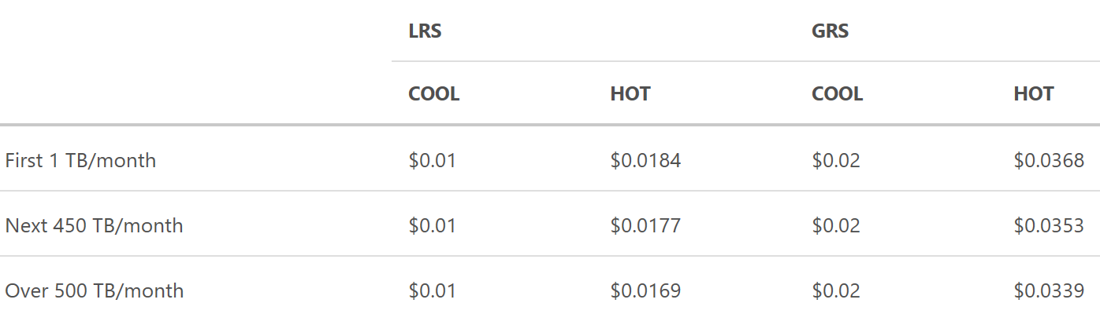
Blob Cool Storage
Hot – for commonly used data
Cool – for rarely used data
No charge for Hot to Cool switch
API is 100% identical; similar throughput and latency
Same durability options: LRS, GRS, RA-GRS
Availability: Cool - 99%, Hot - 99.9%. Higher for RA-GRS reads
Pricing to match your workload
Blob REST API
Blob Storage Account
Hot Tier
Lower Transaction cost
Blob Storage Account
Cool Tier
Lower Capacity cost
Account level conversion

Slide 13
Encryption at Rest
Secure data storage at rest
For Blob Storage service
includes IaaS VM disks
For sensitive data
Healthcare, finance, etc.
Service side
No additional client side overhead
Microsoft takes care of all key management practices
VM Disks
Apps using Blob REST API
Storage Service - Blob Front Ends
(REST API provider, authentication, billing, throttling,…)
Encryption and decryption using MS Managed Keys for every request
Storage Service – Index and Distributed File System
All Data is stored in an encrypted form

Slide 14
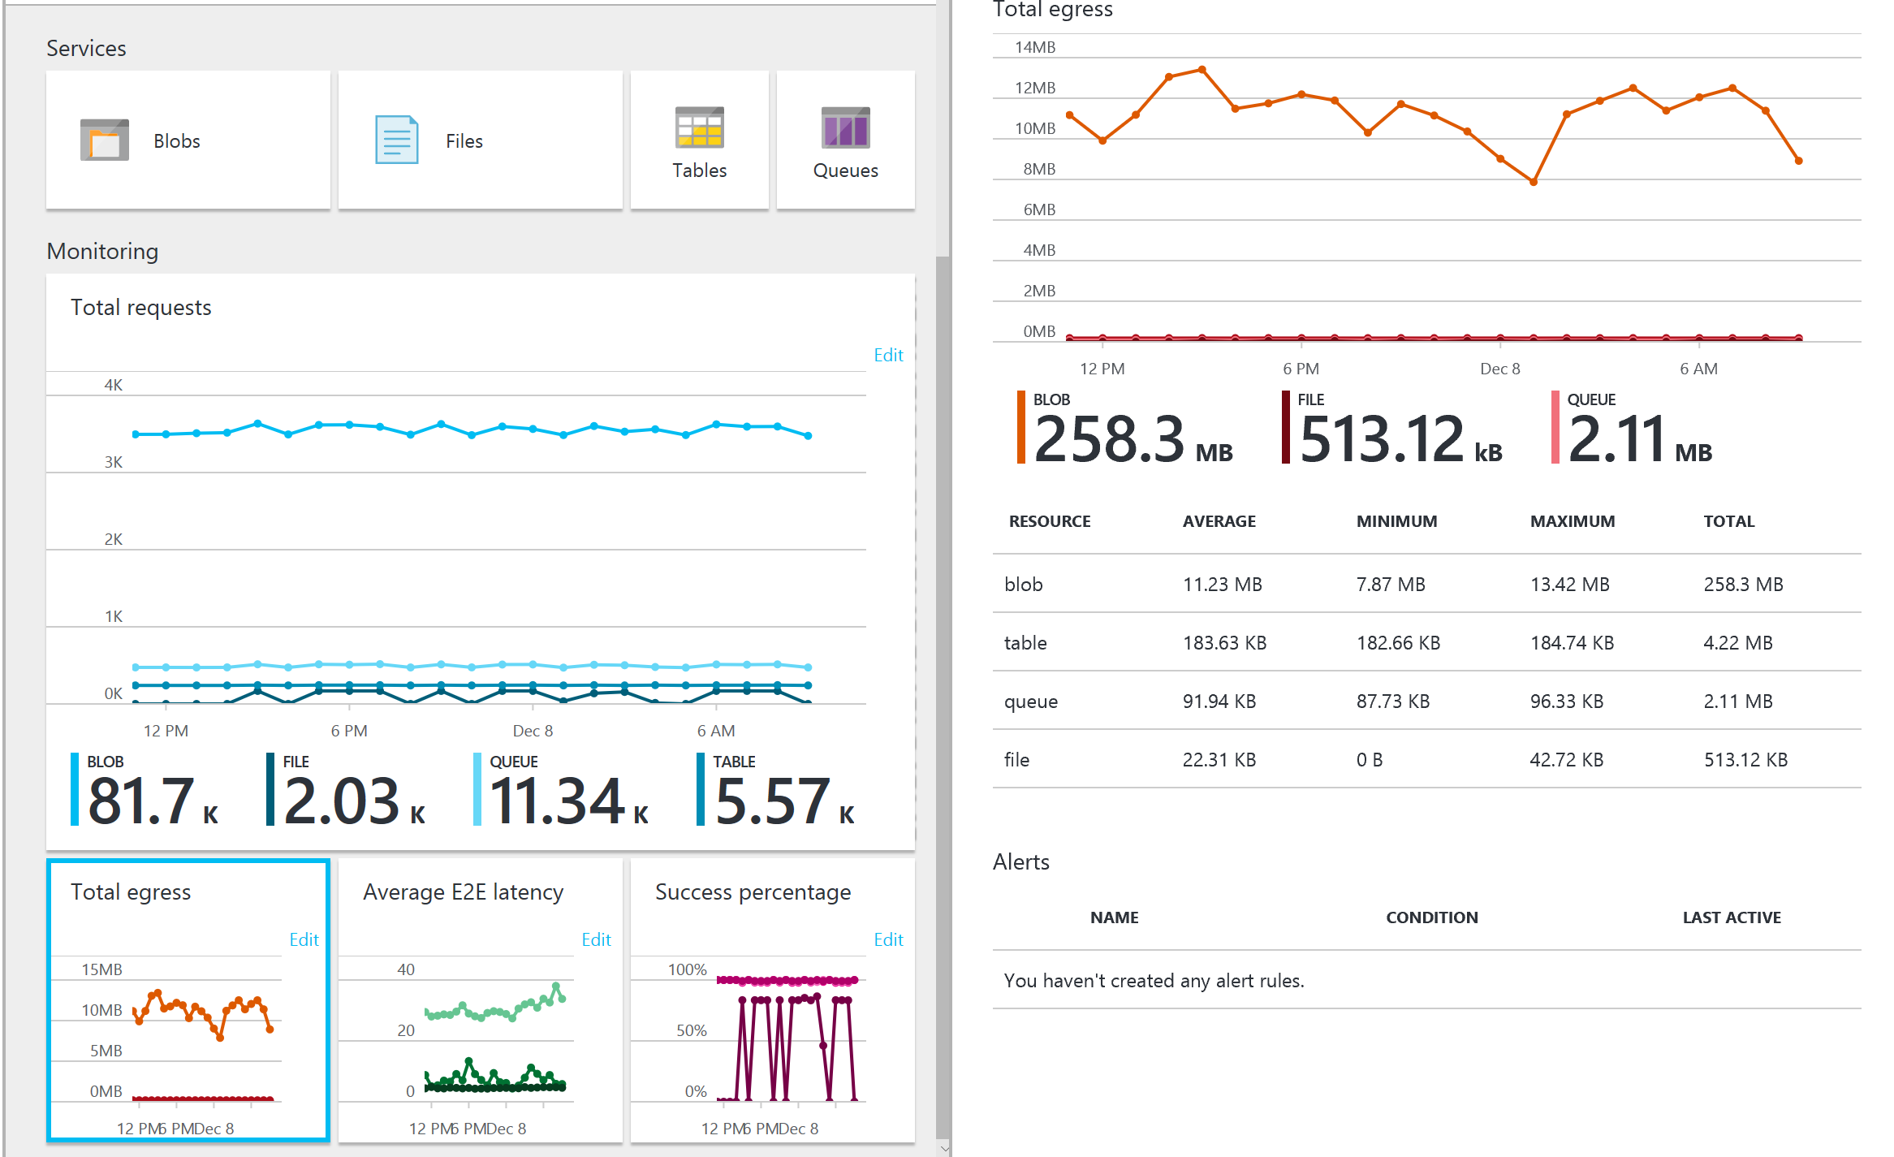
Monitor Storage Usage

Slide 15
SQL Database

Slide 16
Azure SQL Database
Relational database service with mission-critical capabilities, based on SQL Server engine, delivering predictable performance, scalability with no downtime, business continuity and data protection, all with minimal administration
Highly compatible V12 engine
Available in three service tiers
Can change on the fly, by creating a replica of the original database at the new performance level
Some transactions in flight may be rolled back, downtime usually under four seconds
Basic: suited for a small database, supporting typically one single active operation at a given time. Examples include databases used for development or testing, or small-scale infrequently used applications
2 GB max database size, 30 max concurrent workers / sessions
Standard: go-to option for most cloud applications, supporting multiple concurrent queries
250 GB max database size, 200 max concurrent workers / sessions
Premium: Designed for high transactional volume, supporting many concurrent users and requiring the highest level of business continuity capabilities. Examples are databases supporting mission critical applications
1 TB max database size, 6400 max concurrent workers / sessions
Notes:
https://docs.microsoft.com/en-us/azure/sql-database/sql-database-scale-up

Slide 17
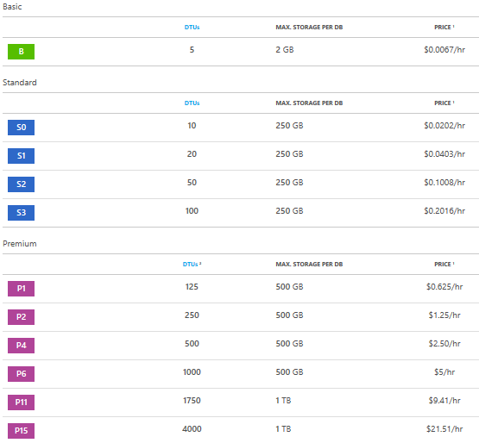
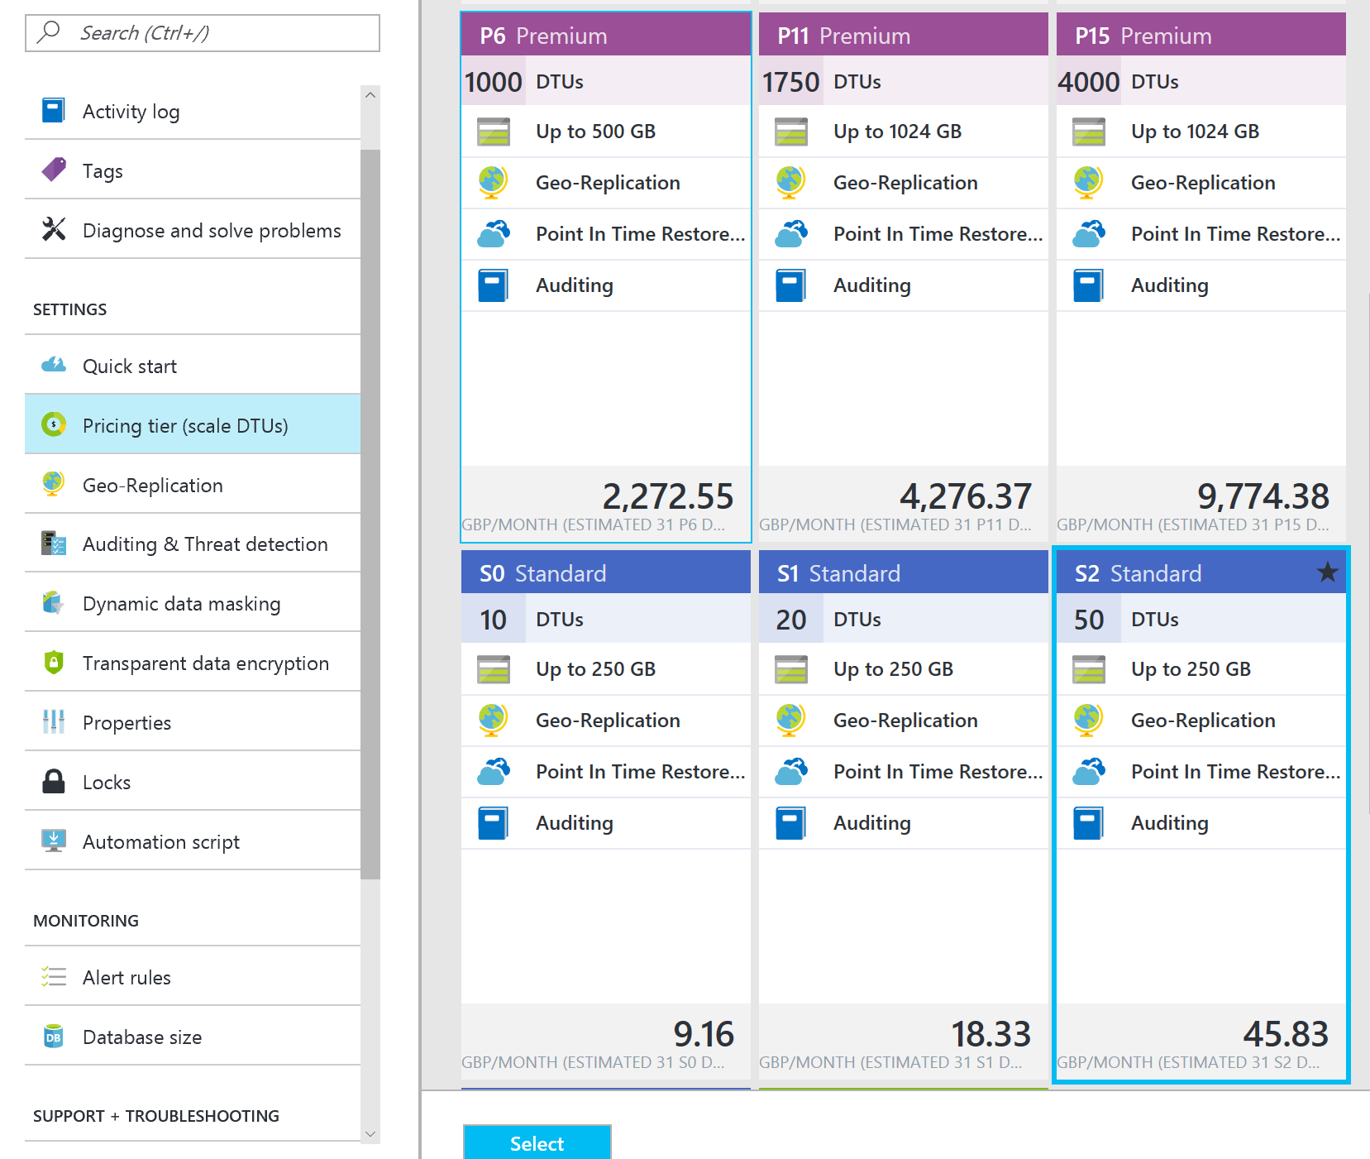
SQL Database – Pricing

Slide 18
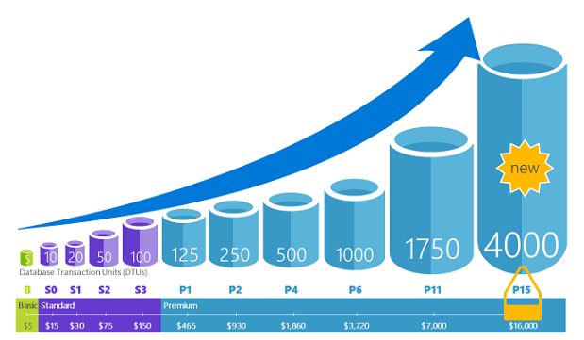
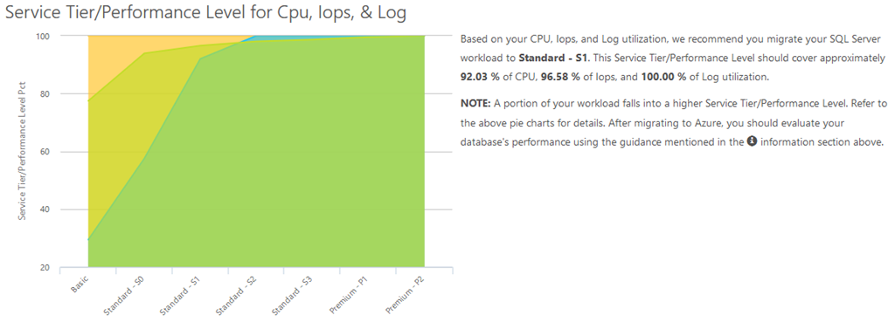
SQL Database – DTUs
Database Transaction Units (DTUs)
measure of CPU, memory, data I/O, transaction log I/O in designed to simulate real-world OLTP workloads
Describes the relative capacity
Azure SQL Database Benchmark (ASDB)
Third party DTU Calculator
dtucalculator.azurewebsites.net

Slide 19
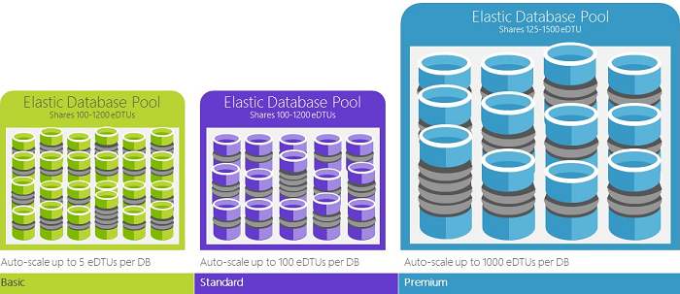
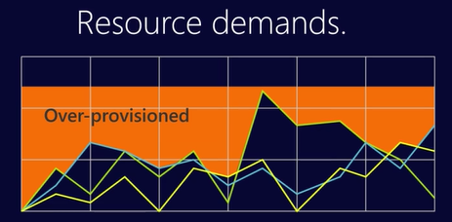
SQL Database – elastic DTUs
Elastic pools provide simple cost effective solution to manage performance goals for multiple databases with varying and unpredictable usage patterns
E.g. multi-tenant solutions using a single-tenant per database
Within the pool, individual databases are given the flexibility to auto-scale within set parameters
Set minimum and maximum DTUs
Avoid auto-provision
Not all single databases are optimum candidates for pools
Notes:
https://docs.microsoft.com/en-us/azure/sql-database/sql-database-elastic-pool
https://docs.microsoft.com/en-us/azure/sql-database/sql-database-elastic-pool-guidance

Slide 20
SQL Database - Business Continuity
Point in Time Restore
Combination of full/weekly/differential database
backups hourly, transaction log backups every five minutes
Retention 7 day (Basic), 35 days (Standard/Premium)
Long-Term Backup Retention feature enables storage of backups in an Azure Recovery Services vault for up to 10 years
Or BACPAC to blob storage

Slide 21
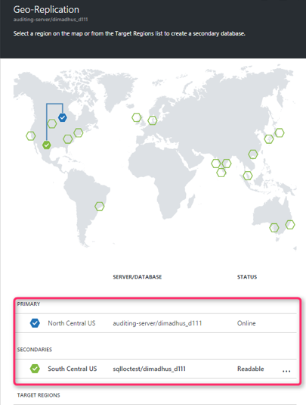
SQL Database - Active Geo-Replication
Active Geo-Replication available in all tiers
Up to four readable secondary databases in the same / different data center locations
Asynchronously replicates committed transactions using Read Committed Snapshot Isolation (RCSI) for isolation
Secondary databases for failover for data center outage or inability to connect to the primary database
Offload workloads such as reporting
Notes:
https://docs.microsoft.com/en-us/azure/sql-database/sql-database-geo-replication-overview
https://docs.microsoft.com/en-us/azure/sql-database/sql-database-designing-cloud-solutions-for-disaster-recovery

Slide 22
SQL Data Warehouse

Slide 23
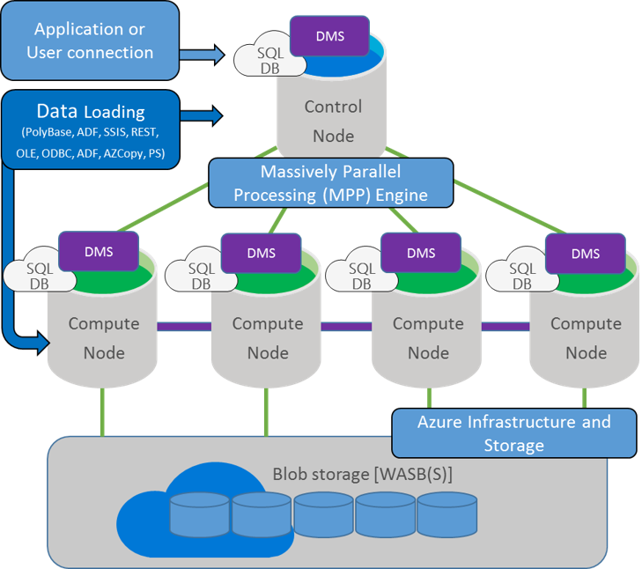
SQL Data Warehouse
SQL Data Warehouse combines the SQL Server relational database with Azure cloud scale-out capabilities, using a massively parallel processing architecture
Scale beyond any single system by using shared-nothing storage and processing units
Control node powered by SQL Database and translates T-SQL to parallel work
Polybase to query or import non-relational data
Pay only for scaled out CPU work and blob storage
Notes:
https://docs.microsoft.com/en-us/azure/sql-data-warehouse/sql-data-warehouse-overview-what-is

Slide 24
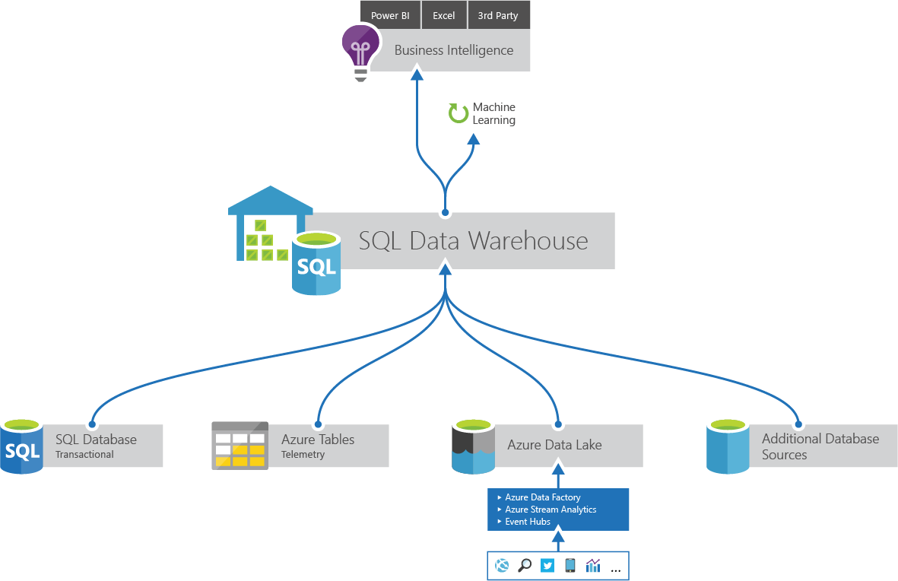
SQL Data Warehouse - DWU
Allocation of resources is measured in Data Warehouse Units (DWUs)
Metric designed to scale linearly
Scan/Aggregation: standard data warehousing query that scans large number of rows and then performs a complex aggregation
I/O and CPU intensive operation
Load: measures ability to ingest data into the service using PolyBase to load data set from Azure Blob storage
stress network and CPU
Create Table: measures the ability to copy a table
CPU, IO and network intensive operation

Slide 25
DW HA/DR
Data Marts
EDW Loading
MPP Data Warehouse
Data Warehouse
MPP Data Warehouse
Transactional Data Sources
(e.g. ERP systems)
ETL and ELT
Staging
MPP Data Warehouse
SQL DW, SQL DB
Data Warehouse
Dynamics, SAP, Siebel, …
Hadoop, HDI, ADF, SSIS,…
WASB, ADL
SQL DW
SQL DW, SQL DB
Caching
Report Execution & Orchestration
Semantic Modelling
Classic Enterprise Data Warehouse
Often for human born data, such as sales
SSAS, AAS
SSRS
SSAS, AAS
End User Consumption
PowerBI, Excel, Tableau, Qlik,,…
HDI – HDInsight
ADF –Azure Data Factory
WASB – Windows Azure Storage Blobs
ADL – Azure Data Lake
AAS – Azure Analysis Services
SSIS – SQL Server Integration Services
SSRS – SQL Server Reporting Services
SSAS – SQL Server Analysis Services
BI & Dashboarding

Slide 26
Hot path (near real time processing)
Virtuous cycle
Lambda Architectures for Big Data
Often for machine born data, such as telemetry
Continuous Processing
ASA,…
BI & Dashboarding
Data Sources
(e.g. sensors, devices, telemetry)
Cloud Data Ingress Hub
End User Consumption
Feedback Loop
PBI, Tableau, Qlik, Excel,…
IoT Hub, Event Hub, …
AML, R, ACS, …
MPP Data Warehouse
Caching
Report Execution & Orchestration
Semantic Modelling
Data Lake
MPP Data Warehouse
MPP Data Warehouse
ADL, HDI
SQL DW
SSAS, AAS
SSAS, AAS
SSRS
Continuous Load
Cold path (batch processing)
DW HA/DR

Slide 27
Analysis Services

Slide 28

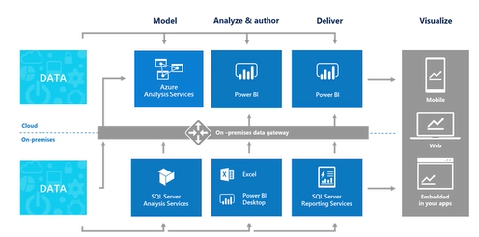
Azure Analysis Services
Proven analytical engine in the cloud that provides enterprise-grade data modelling
In Preview
Design a user centric “semantic model” of the data
Sits between data source and end user
Reporting and dashboards, such as Power BI
Typically star/snowflake schema
Notes:
http://sqlmag.com/sql-server-analysis-services/starting-your-modeling-career-analysis-services-tabular-models-part-1

Slide 29
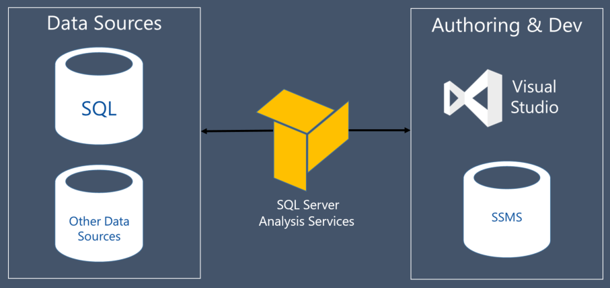
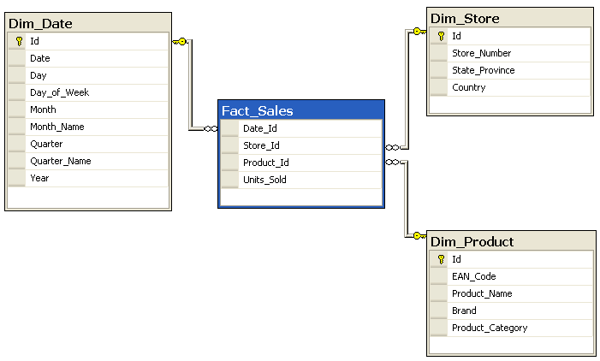
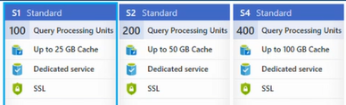
Azure Analysis Services
Tabular Model
Vertipaq in-memory engine
4 – 10+ factor compression
Design star/snowflake schema
Fact tables referencing dimension table
Aggregate up & drill down dimensions
Billing is cache size and query processing units

Slide 30
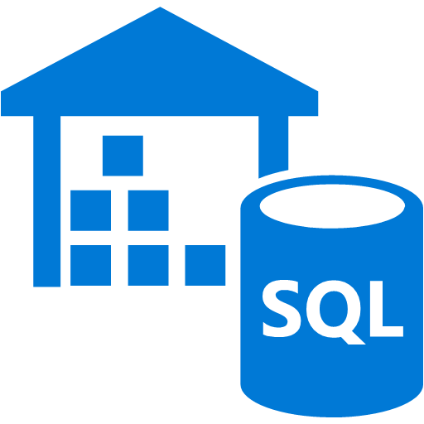

Data Warehousing On Azure
Capture
Curate
Consume
Data Sources
Ingest
Sanitize
Warehousing
Caching
Visualize
Business apps
Writes to
Transactional store
Power BI
Azure Blob storage
Generate Facts and Dimensions
From Source Tables in Blob
SQL Data Warehouse
(Data Mart)
OLTP SQL Database
<>
Scheduled
Cache Refresh
Sync source tables at
hourly interval to partitioned
store in Blob
Insert incrementals via Polybase
Jupyter Notebook
HDInsight Hive
Data Factory: Move data, orchestrate, schedule and monitor

Slide 31
DocumentDB

Slide 32



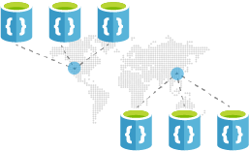
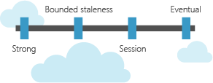
DocumentDB (NoSQL)
It’s a NoSQL store
Query using familiar SQL / JavaScript syntax & MongoDB
Guaranteed low latency
< 10 ms on reads, < 15 ms on writes
Replicate and scale data globally
Replicates your data to any number of regions worldwide
Choice of four consistency models
Strong, bounded staleness, session, and eventual

Slide 33
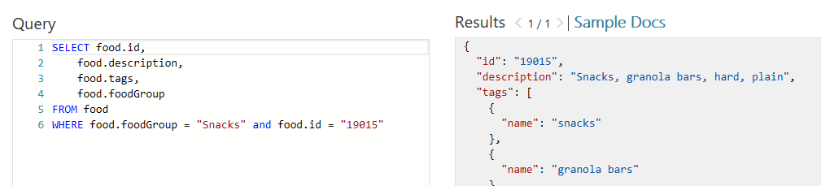

NoSQL
Ad hoc queries with familiar SQL syntax
Uses highly concurrent, lock free, log structured indexing technology to automatically index all document content
LINQ query support for .NET
Procedures, triggers and user defined functions (UDFs) natively in JavaScript

Slide 34

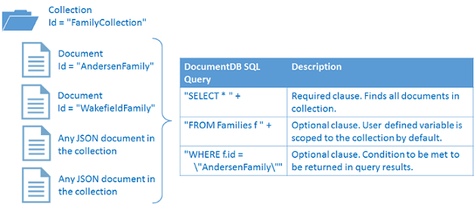
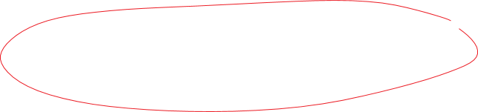

Code access
"id": "AndersenFamily", "lastName": "Andersen", "parents": [ { "firstName": "Thomas" }, { "firstName": "Mary Kay"} ], "children": [ { "firstName": "Henriette Thaulow", "gender": "female", "grade": 5, "pets": [
{ "givenName": "Fluffy" }] } ], "address": { "state": "WA", "county": "King", "city": "seattle" }, "creationDate": 1431620472, "isRegistered": true

Slide 35
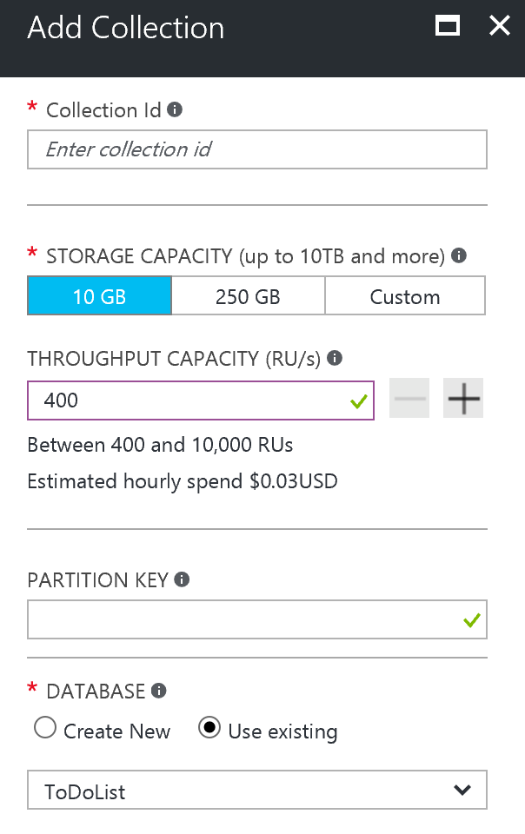
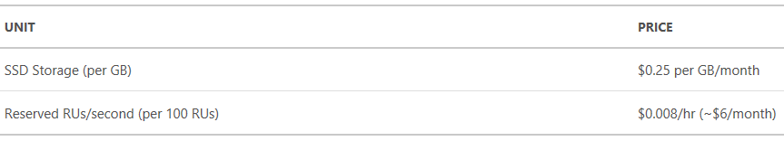
Pricing
Two elements to pricing
SSD backed store (GB)
Throughput (Request Units)
1 Request Unit (RU) corresponds to throughput of a GET of a 1KB document
Abstraction of CPU, IO and memory
All operations have deterministic RU value, returned in header
www.documentdb.com/capacityplanner

Slide 36
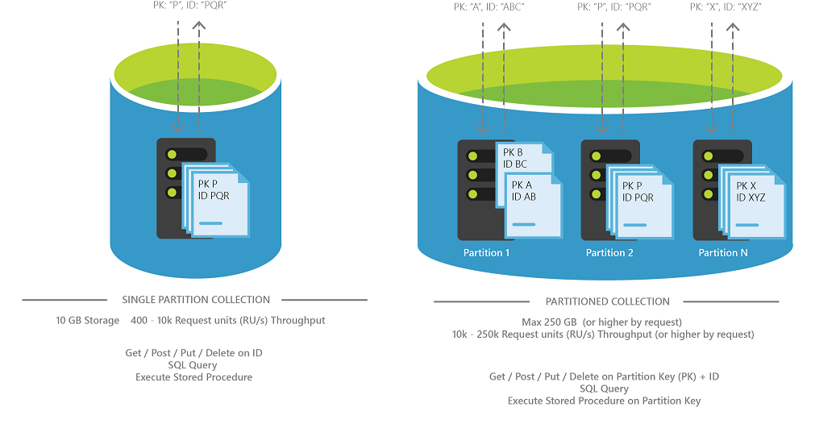
Partitioning
Partitioning is completely transparent to your application
Service handles distributing of data and query requests
Single or multiple partition model
Every partition has a fixed amount of SSD-backed storage
Which is replicated for high availability

Slide 37
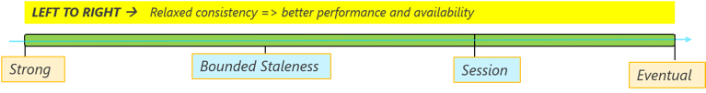
Consistency
DocumentDB provides four consistency levels
Strong
Bounded-staleness
Session
Eventual
CAP theorem (aka Brewer's) states It is impossible for a distributed system to simultaneously provide more than two out of three of the following guarantees:
Consistency - Every read receives the most recent write or an error
Availability - Every request receives a response, without guarantee that it contains the most recent write
Partition tolerance - System continues to operate despite an arbitrary number of messages being dropped (or delayed) by the network between nodes
“strong” is fully CP and “Eventual” is fully AP

Slide 38
Thank You
Part 2 after coffee…

